Slide 2
" In The Name of Allah, The Most Beneficent, The Most Merciful" Globalization of Halal Standard By: Dr. Hani M. Al-Mazeedi

Slide 3
Scope:
This presentation will tackle Halal Standard as a global standard from these hot issues:
As a Promoter of Trade.
As a guideline for better Marketing.
Its current situation.
How to resolve disputable issues?

Slide 4
Content
Introduction
Halal as a Promoter of Trade
Halal Guidelines for better Marketing
Current situation of Halal
Global Market potential of Halal
Resolving disputable issues
Issues raised at International Industry Dialogues
The meaning of Halal and Tayyib
How to move forward?
Conclusions

Slide 5
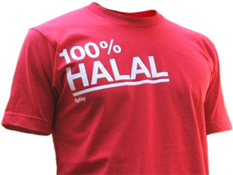
Introduction
The main target of the Global Halal Standard is:
To strengthen the obligatory religious requirements of Halal.
To avoid Haram in Halal certified products.
To avoid technical barriers.
To increas economical relations and cooperation in the World.

Slide 6
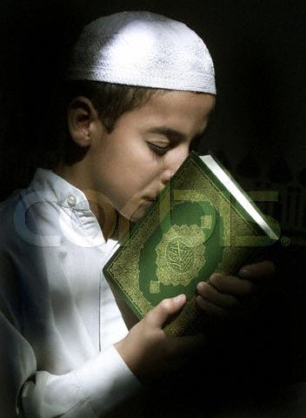
Halal as a Promoter of Trade
When proposing a global Halal standard the expected challenge is:
How to harmonize existing Halal practices as approved by sharieah of different schools on one common ground to promote trade?

Slide 7
Halal Guidelines for better Marketing
The proposed global Halal standard in its initial stage should be:
Guidelines and not standard to give flexibility and room to encompass controversial issues on Halal among different Islamic schools.

Slide 8
Current situation of Halal
The Halal Industry
This Industry is unique in the sense that it is an industry where Islamic values, ideals and beliefs are implemented and adhered within the whole chain of the Halal production process.

Slide 9
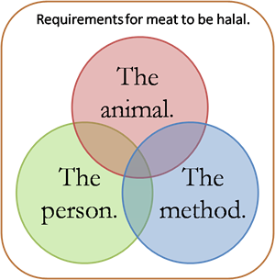
Given that certain aspects of the Halal meat procedure cannot be fully verified at a later stage through random sampling and testing, very close and continuous supervision is necessary.

Slide 10
Global Market potential of Halal
Global Halal products market is on the level of trillions of USD (excluding Islamic banking):
Food & Beverage: 70%.
Pharmaceutical: 22%.
Personal care & cosmetics: 10% .
As it can be seen the key sector for the Halal Market is the food sector.

Slide 11
Halal cover the following modules:
Meat & Poultry – Slaughter Practices
Food Manufacturing
Food Retailing
Restaurant Chains
Food Service Industry
Pharmaceuticals & Healthcare products
Logistics & Shipping
Islamic Banking & Finance
Testing and analysis

Slide 12
Resolving disputable issues
Issues to consider when marketing Halal products:
Slaughter Methods (stunning , post-stunning, thoracic sticking, time of death, and mechanical slaughter).
Istihala or change of state (gelatin, bovine based of non- Halal slaughtered animals, pork based gelatin, enzymes, and fat based animal).
Fish items (what to consider and what not to consider as Halal).

Slide 13
Animal Feed (Haram animal by products in herbivore animal feed)
Alcohol Tolerance (zero tolerance, Low tolerance of 0.1%, Alcohol Types such as ethanol: industrial or fermented, and methanol).
Slaughterman (only Muslim, Ahlulkitab of Christian or Jew faith)
Genetically Modified Food (use of non-Halal source animals/organisms, labeling, and moral & safety Issues)
Testing & Analysis (sampling, standard operating procedures for Halal Testing and Global laboratory mutual recognition, non-Muslim laboratory technicians)

Slide 14
Supply Chain Integrity (Halal logistics such as warehouse, cold rooms, containers, ports, traceability, and Islamic banking & finance)
Judgments (lack of Islamic scholars with relevant industry knowledge).

Slide 15
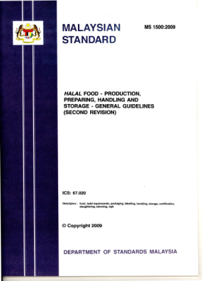
Issues raised at International Industry Dialogues:
Certification agencies not industry friendly.
Certification agencies do not follow SOPs, Quality Management Systems, etc.
Halal Auditors do not have relevant industry knowledge (Shariah centric).
Competing national standards.

Slide 16
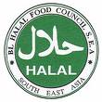
No mutual recognition amongst Certification Bodies.

Slide 17
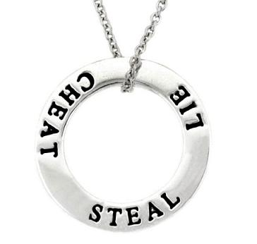
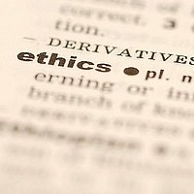
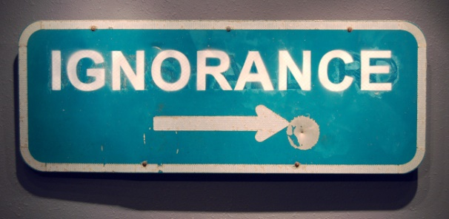
Domestic Labeling not comprehensive – non-Halal ingredient loopholes.
Lack of Industry awareness on the benefits of Halal standardization .
Misconception of Halal by Non-Muslims.

Slide 18
The meaning of Halal and Tayyib
Animal welfare
Healthy and wholesome
Environmentally friendly
Organic
Ethical
Fair Trade

Slide 19
How to move forward?
Halal Certification Bodies (HCB) must be accredited to cary out the suggested Halal Model as multiple Halal standards and not as one Halal standard!
But How?

Slide 20
We should have a series of Halal standards
ISO XYZ 0000 for General Halal standard
ISO XYZ 0001 for Halal as approved by Hanbali school.
ISO XYZ 0002 for Halal as approved by Hanafi school.
ISO XYZ 0003 for Halal as approved by Shafiei school.
ISO XYZ 0004 for Halal as approved by Maliki school.
ISO XYZ 0005 for Halal as approved by X school.

Slide 21
Conclusions
It is the sharieah scholars of well known knowledge along with experts in related sciences to the Halal industry such as veterinarians, chemists, food scientists, and pharmacists that together formulate a global Halal Model based on:

Slide 22
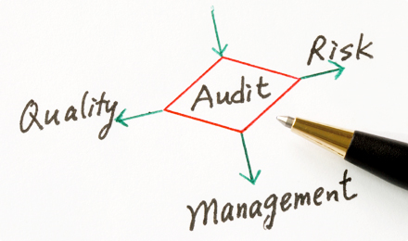
1) Islamic values, ideals and beliefs as approved by sharieah and
2) on the recognition of related International Standards (Audit, Traceability, Food safety HACCP i.e. ISO22000), GMP, EU Standards, Logistics, Laboratory Testing i.e. ISO 17025, etc.).

Slide 23
The global Halal model should encompass all Halal modules. Industry players need to be engaged with at the onset to ensure buy-in.
Once the global Halal Model have been finalized, local governments will verify it for its adoption initially as a suggested Halal guidelines to promote its implementation.
Latter, the suggested model will be modified to produce International Halal Standards.

Slide 24
References
Jumaatun Azmi (2008). The Global Halal Industry, 9th MEETING OF THE OIC STANDARDISATION EXPERTS GROUP, 16-18 April, 2008 in Ankara, Turkey.
Development of a Halal Food Standard for OIC (2008). Çiğdem KILIÇKAYA, Special Meeting of Standardization Expert Group, April 16, 2008.
The Halal Market in the World (2012). BOUZARIF Lahcen
Techno Economical Aspects of the Halal Industry and its Services (2011). Irfan Sungkar, Senior Economist & Halal Industry Consultant, Director, PT. Green Research, Indonesia.

Slide 25
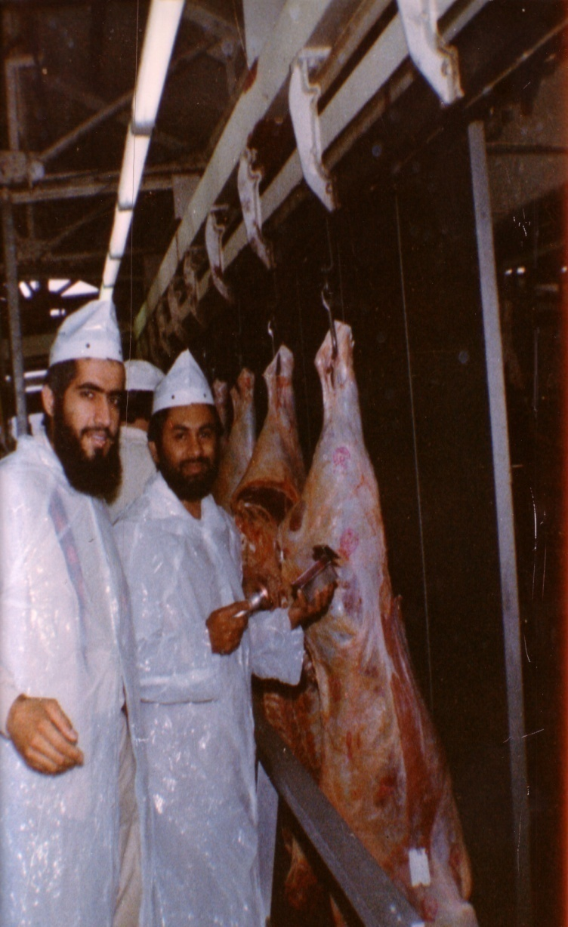
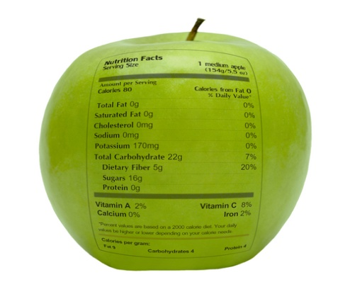
شكراً لاستماعكم
سبحنك اللهم وبحمدك أشهد أن لا إله إلا أنت، أستغفرك وأتوب إليك
د. هاني منصور المزيدي
مع الأخ أمجد محبوب في أستراليا سنة 1981
Dr. Hani Mansour Al-Mazeedi
With brother Amjad Mahboob in Australia in 1981

Slide 26
www.HalalEA.com
Trademarks, icons, images belong to their respective owners.
© Halal Sciences Academy Limited

